Slide 1
Historical Hurricane Analysis
Cody Wittmaack
Notes:
Hello my name is Cody Wittmaack and today I’ll be taking you through my capstone project…..a Historical Hurricane Analysis.

Slide 2




Data Sources
Temperature Data - National Centers for Environmental Information - https://www.ncei.noaa.gov/
North Atlantic Hurricane Occurrences - Our World in Data - https://ourworldindata.org/grapher/frequency-north-atlantic-hurricanes
Landfall Hurricane Occurrences - Historical Global Tropical Cyclone Landfalls - Jessica Weinkle, Ryan Maue, & Roger Pielke Jr - https://journals.ametsoc.org/view/journals/clim/25/13/jcli-d-11-00719.1.xml?tab_body=pdf
Coastal Population Data - National Oceanic & Atmospheric Administration - https://coast.noaa.gov/quickreport/#/index.html
Hurricane Damage Data - National Centers for Environmental Information - https://www.ncei.noaa.gov/access/billions/time-series/US
Technologies Used
Data Cleaning
Google Sheets
Python
Jupyter Notebook
Exploratory Data Analysis
Python
Pandas
Matplotlib
Seaborn
Jupyter Notebook
Visualizations
Tableau
Python
Seaborn
Matplotlib
Notes:
First, here is a list of data sources & tech used for the analysis.

Slide 3
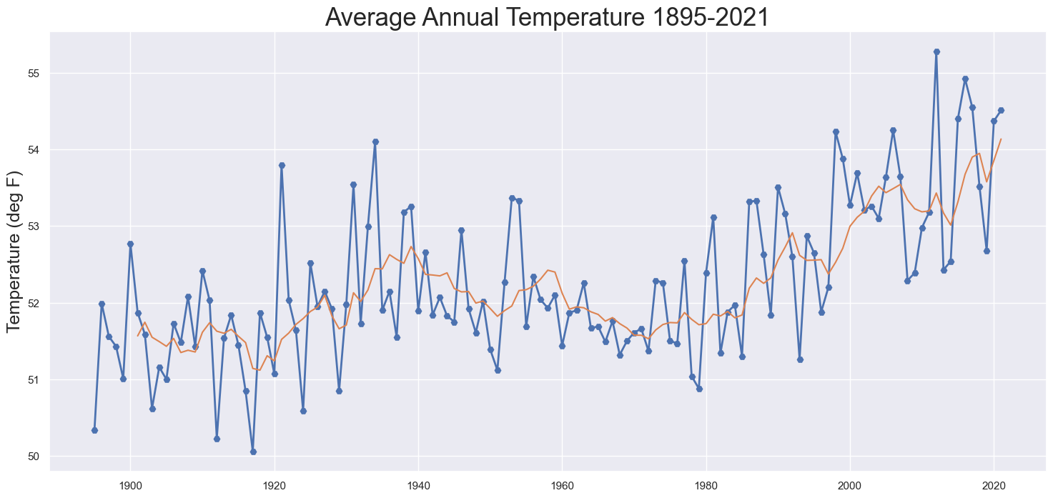
Global Warming
Average global surface temperature has risen at a rate of 0.17°F per decade since 1900 or roughly 2°F from 1900 to 2020.
Notes:
Global warming isn’t really up for debate. This graph plots the average surface temp of earth for each year from 1895 to 2021. As you can see in this graph there is certainly a warming effect taking place.

Slide 4
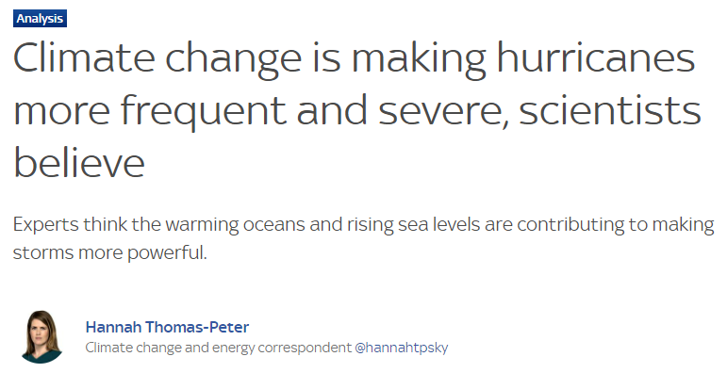
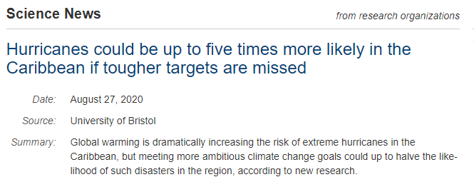
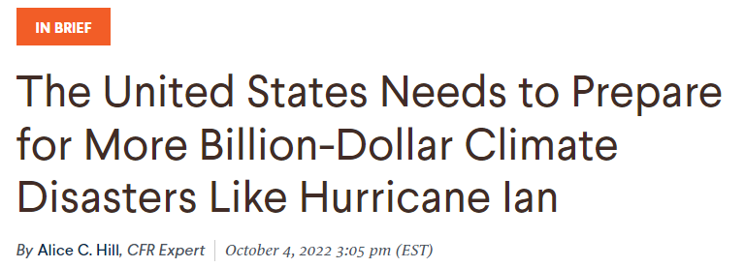
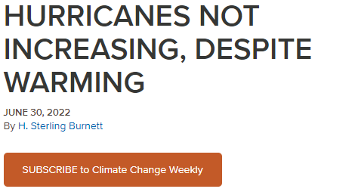
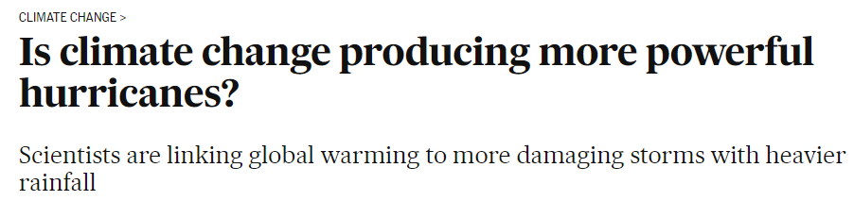
Is Global Warming Impacting the Frequency or Intensity of Hurricanes?
Notes:
The question I’m looking to answer is whether or not this warming is impacting the frequency or intensity of hurricanes.
A simple google search on the topic will likely leave you scratching your head.

Slide 5
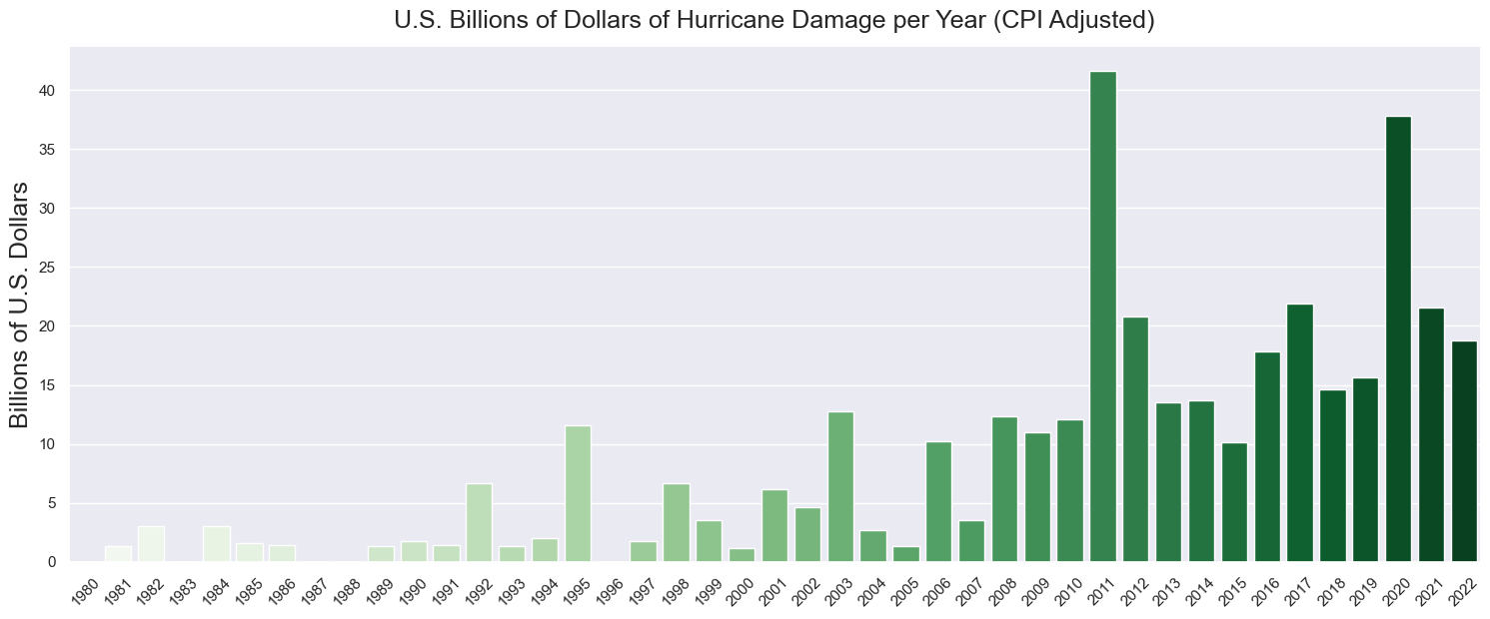
Hurricane Damage is Increasing!
Notes:
This graph shows the damage in billions of dollars caused by hurricanes in the U.S. from 1980 to current day. This would would likely lead you to believe storms more frequent and intense.
……..
Next I was able to find data that tracked occurrences of each hurricane event from 1895 to 2021 in the North Atlantic Basin…….CLICK

Slide 6
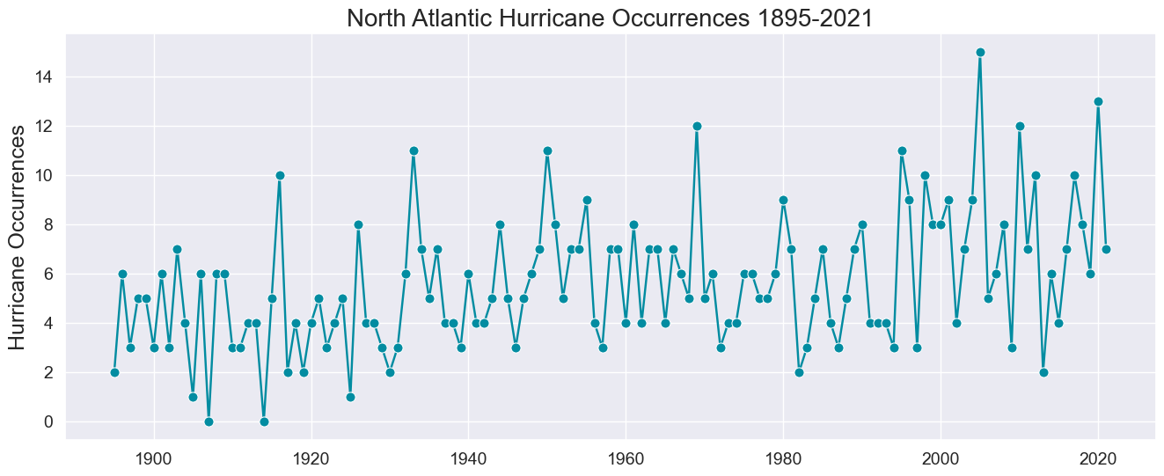
Notes:
As you can pretty clearly see there does appear to be an upward trend in occurrences over this period…..CLICK.

Slide 7
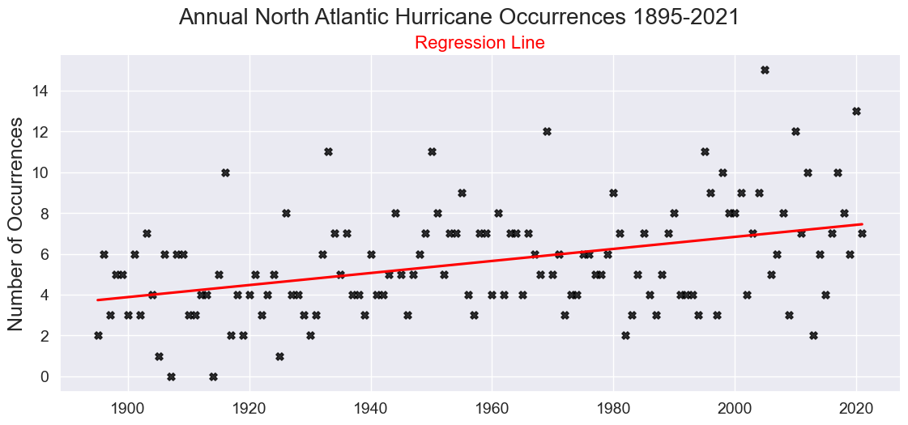
Notes:
A regression line of these events further supports an increase in hurricane activity.

Slide 8
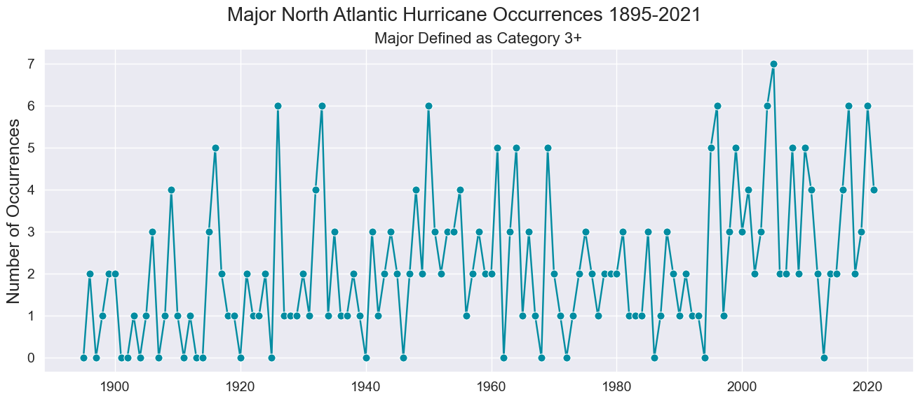
Notes:
Here we look at only category 3 storms & stronger (111-129 mph) to measure intensity.

Slide 9
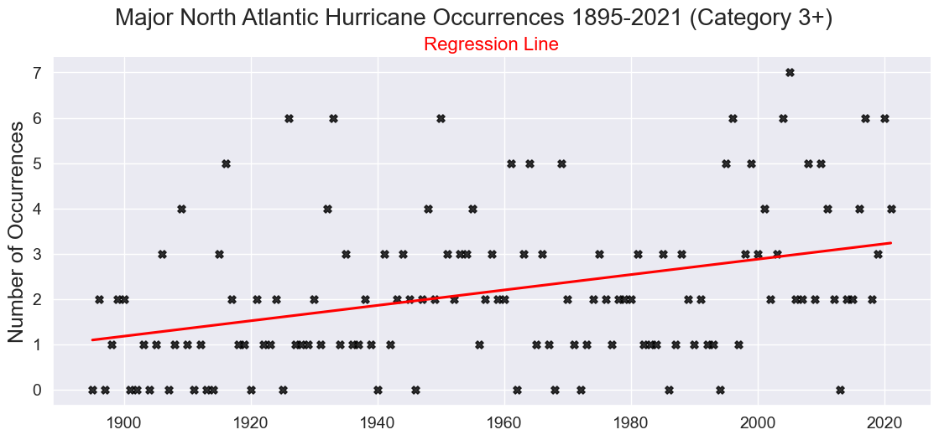
Notes:
AND again here the regression also seems to support an increase in frequency of these storms.

Slide 10
Back to the question at hand…
Is Global Warming Impacting the Frequency & Intensity of Hurricanes?
Based on that data…it certainly appears to!
But let’s take a closer look at the data before drawing a conclusion.

Slide 11
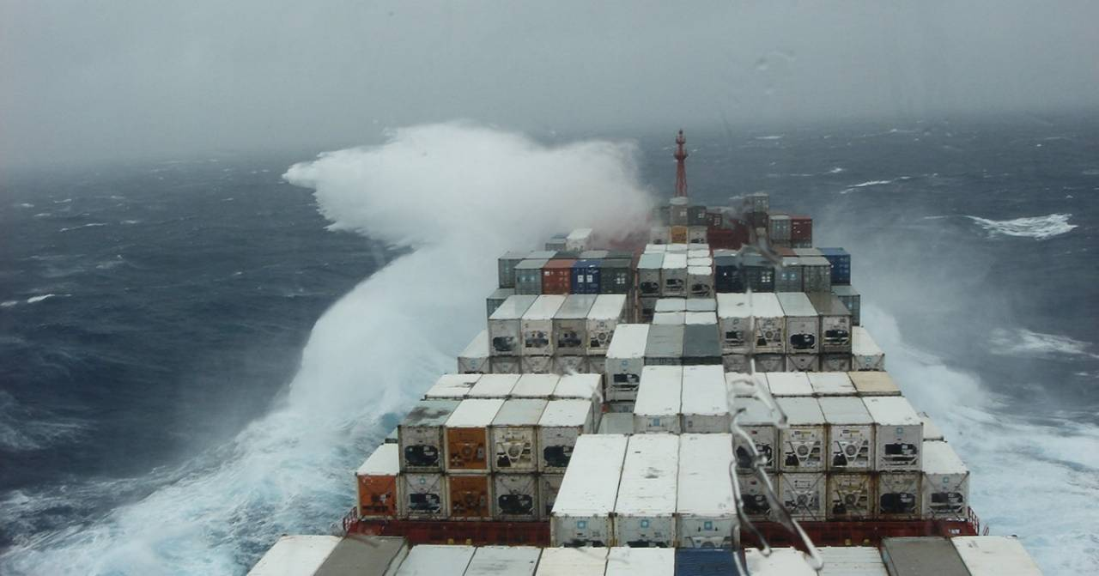
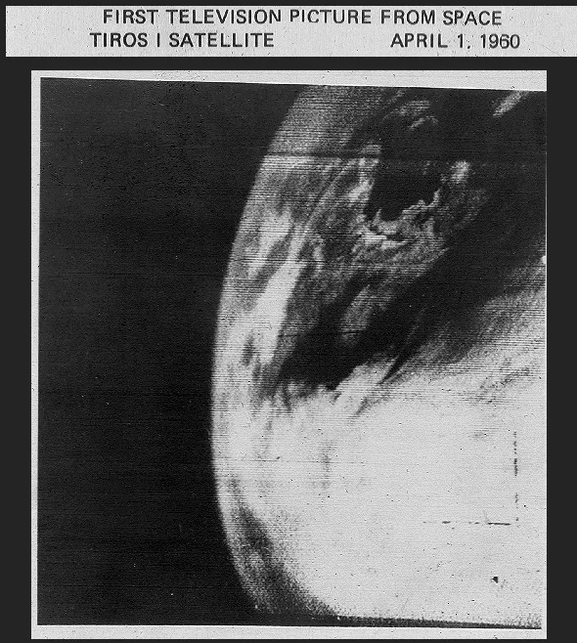
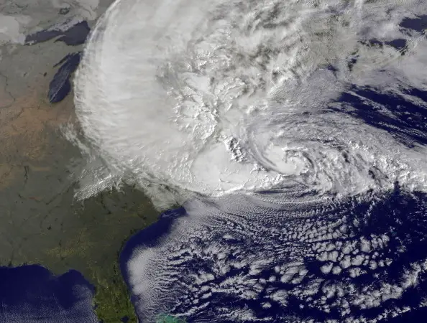
Hurricane Detection
Early Detection
Reported by ships
Landfall
Primary methods until early 1970’s
Modern Detection
Satellite imagery
First image generated on 4/1/1960 but not considered reliable until around 1972
Notes:
To better understand the data we need to also understand how the data was collected.

Slide 12
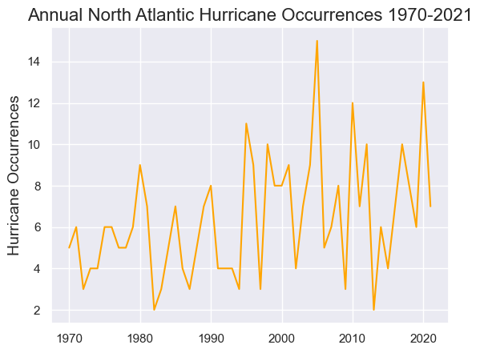
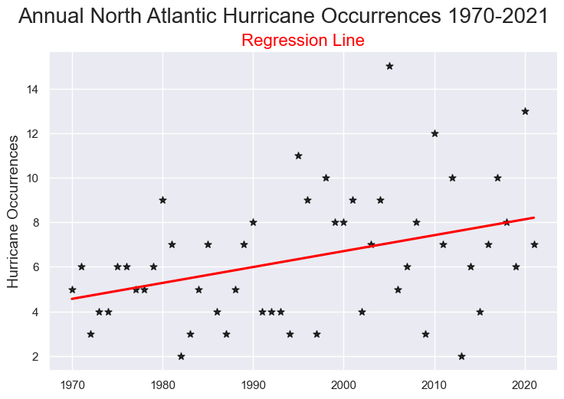
Why Does this Matter?
It is likely hurricanes prior to satellite technology were undercounted.
This would skew the data!
How can we reconcile this?
Notes:
READ BULLETS……
Maybe we can look at data starting in 1970? CLICK….As we can see looking at the same data set starting in in 1970 we still see an upward trend. CLICK. The regression line also supports an increase in hurricane activity. CLICK

Slide 13
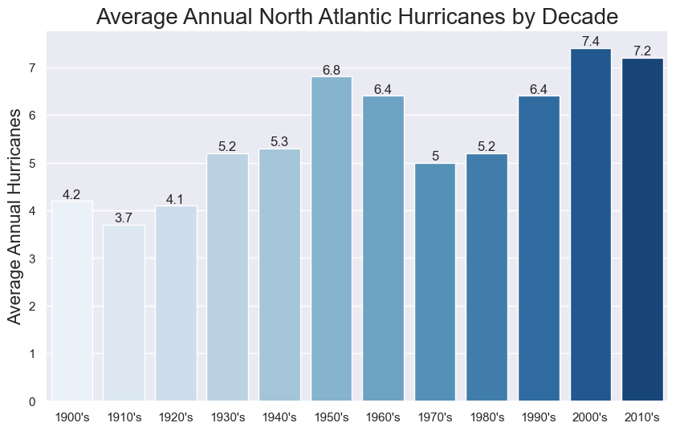
Conclusion? Not so Fast!
The smaller sample size allows outliers to more significantly influence the conclusion.
Notes:
Read Slide……….If more storms can be identified starting in 1970 why would the 70’s & 80’s lag behind the two previous decades? The most reasonable explanation is a natural lull in hurricane activity over that period..
To solve for this I looked at only landfall hurricane events. We have good records starting in 1950 for the Atlantic and West Pacific Basin which accounts for about 70% of all global landfall events.

Slide 14
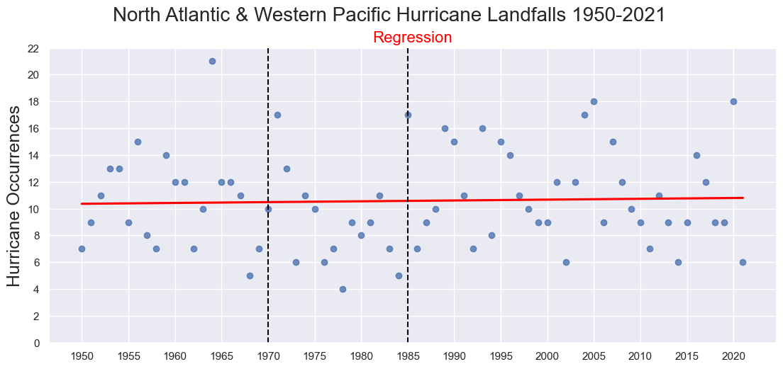
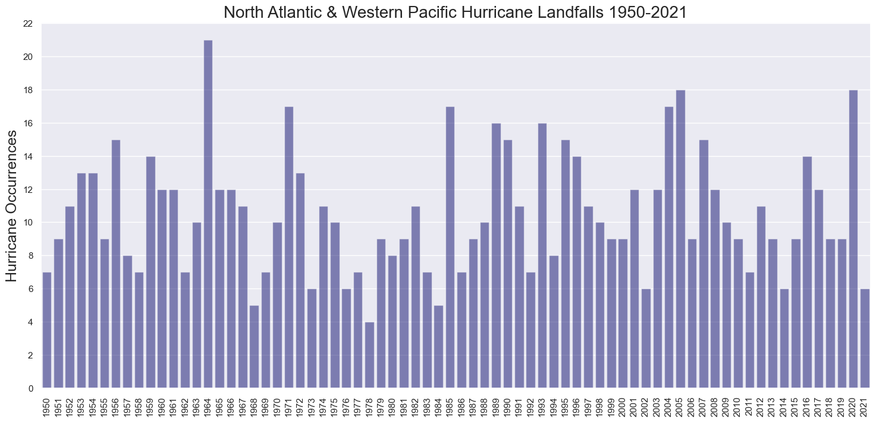
Landfall Analysis - Frequency
Notes:
Here is a quick look at a bar chart of that data. It’s a little difficult to tell the trend here but looks fairly evenly distributed. Here is another look with a regression line for reference. As you can see the line nearly flat.
The period between the dotted lines also appears to support a lull over that period in this data set.

Slide 15
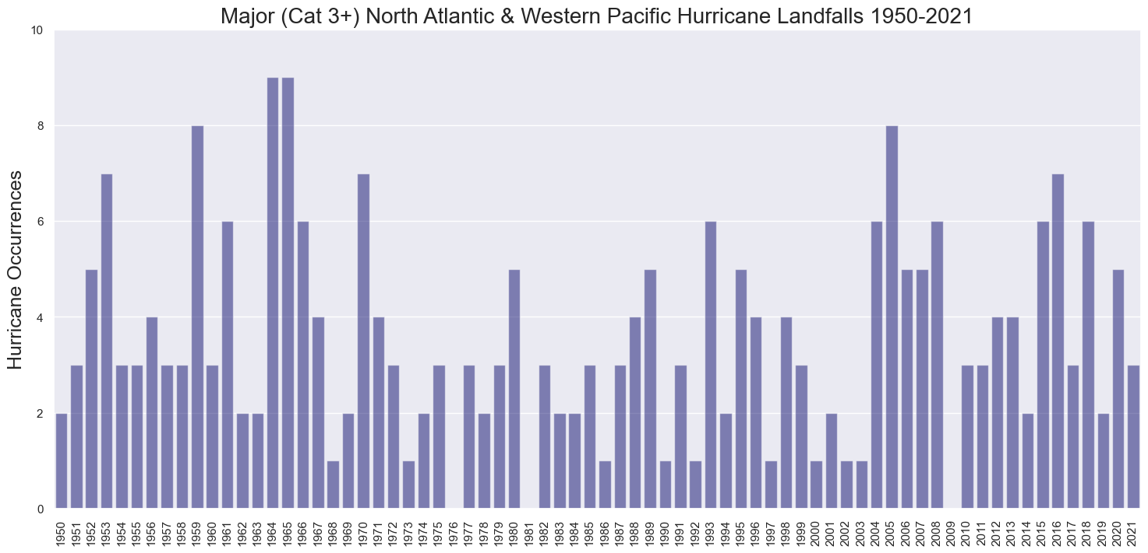
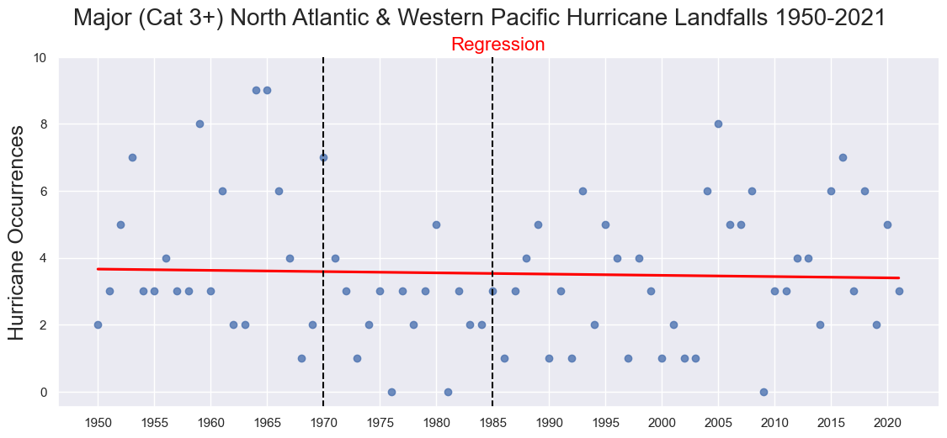
Landfall Analysis - Intensity
Notes:
Here we’re looking at only the category 3 and stronger hurricanes. Once again they are pretty evenly distributed and the regression shows a slight decrease.

Slide 16
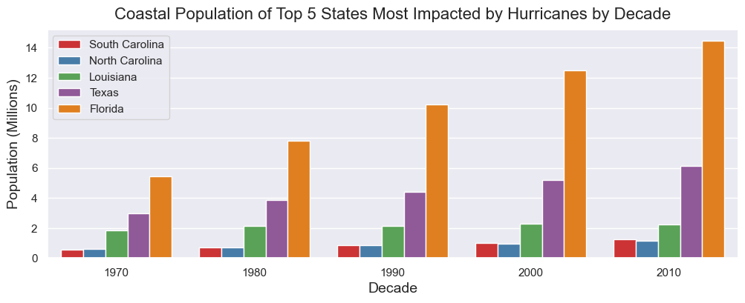
What About the Increase in Damages though?
Notes:
Given what we’ve seen how can we explain the increase in storm damage that we previously looked at? CLICK.
One explanation is likely that coastal population and infrastructure has grown exponentially over the years. This graph displays the coastal populations of the 5 states most impacted by storms. As you can see most of these areas have grown 2-3 times from the 70’s to 2010’s.

Slide 17
Conclusion
“Data doesn’t lie. People do. If your data is biased, it is because it has been sampled incorrectly or you asked the wrong question, whether it be deliberately or otherwise.” - Lee Baker, Truth, Lies, & Statistics: How to Lie with Statistics.
The true story highlighted in this analysis is how data can be used to drive a narrative in almost any direction.
This analysis indicates no strong evidence of increasing frequency or intensity of Hurricanes.
Notes:
This is not to say climate change isn’t taking place.
Some evidence of hurricanes moving more slowly resulting in more rain being deposited in an area and causing more damage as a result.
With that thank you for your time and I hope this has been insightful.

